Slide 1
Chapter 6: Shape of the Distribution

Slide 2
Learning Outcomes
After Completing the chapter ,you will able to :
Measures the Shape of the distribution
Compute Skewness and Kurtosis with interpretation

Slide 3
Contents
    From this lecture, you are going to learn…
Skewness with it's types?
How to calculate skewness and interpretation.
Kurtosis with it's types.
Calculation of kurtosis.

Slide 4
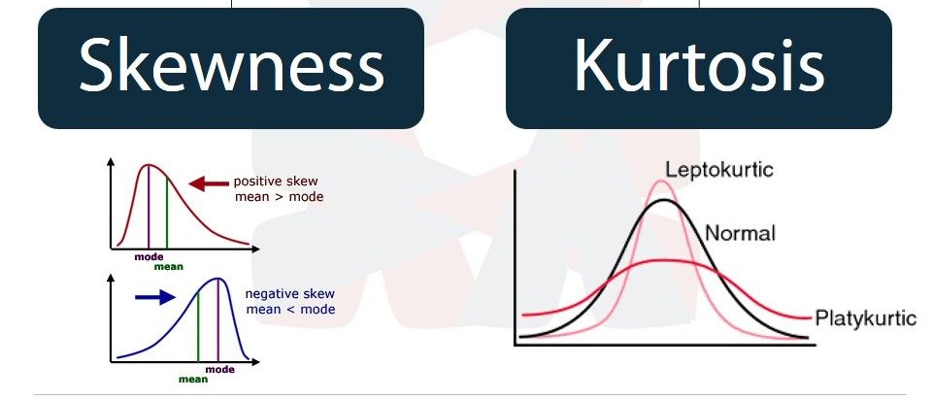
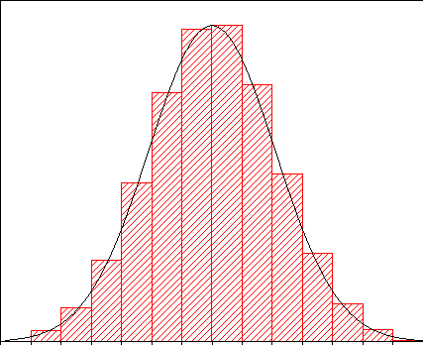
Shape of the Distribution
The shape of a distribution is described by its number of peaks, where the peak is occurred and by its tendency to skew, or its uniformity.
Two numerical measures of shape give a more precise evaluation:
Normal distribution

Slide 5
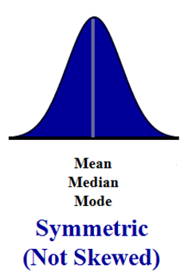
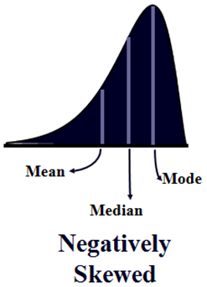
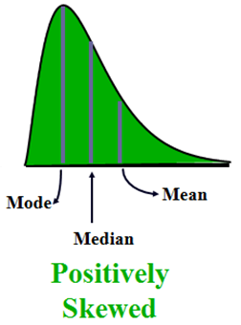


Skewness
Skewness: Skewness is the measurement of the lack of symmetry (amount and direction of skew) of the distribution. That is when a distribution is not symmetrical it is called a skewed distribution.
Skewness is of 2 types
Long tail in left direction
Long tail in right direction
Mean = Median =Mode

Slide 6

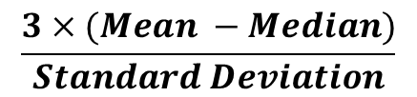
Skewness
How to measure Skewness in the data set?
Coefficient of Skewness, Sk =
Range = (-3 to +3)
Interpretation:
(-3 to -2)
(-2 to -1)
(-1to 0)
(0-1)
(1-2)
(2-3)
Strongly Negatively Skewed Distribution
Moderately Negatively Skewed Distribution
Weakly Negatively Skewed Distribution
Weakly positively Skewed Distribution
Moderately positively Skewed Distribution
Strongly positively Skewed Distribution
-3
-2
-1
1
2
3
0
**Suppose If SK_{p} = -1.75; the distribution is moderately skewed which is negative.
Sk = 0
symmetric Distribution
**Suppose If SK_{p} = .75; the distribution is weakly skewed which is positive.

Slide 7
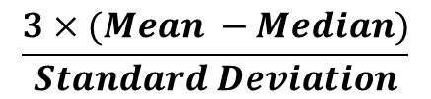




Example
Solution:
We know that,
Coefficient of Skewness, Sk =
(2, 4, 6, 15,18. So the middle value is 6)
So there is a moderate positive skewness in the data set.

Slide 8
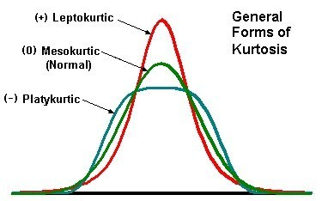
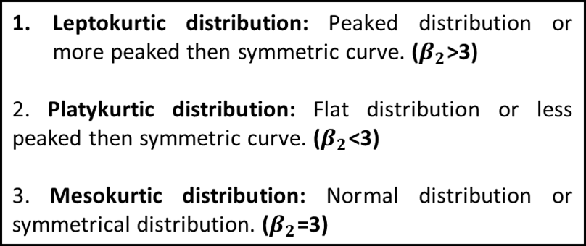
Kurtosis
Kurtosis: Kurtosis measures the degree of flatness or peakness of a distribution relative to a standard bell curve.
Three types of distributions with respect to kurtosis:

Slide 9
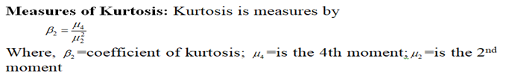


Kurtosis

Slide 10
Exercise..
Marks of 10 students in a class.
15, 25, 48, 50,65,95,18,85,75,55. Calculate coefficient of skewness and interpret the result.
Time of reading newspaper of 6 people(in hour)
3,4,2,4,6,2,5.
Calculate coefficient of kurtosis.

Slide 11


